Slide 1


Data Mining & Foundations of AI (Assessment 2) Module: 6CC555
Student ID: 100540796
University Of Derby - School of Computing and Engineering
Notes:
Welcome to my presentation on the Data Mining & Foundations of AI module, assessment 2.

Slide 2

Introduction
Objective: Develop a predictive model for diagnosing pneumonia using chest X-ray images.
Data Source: Utilise a comprehensive dataset from Kaggle featuring X-ray images of patients diagnosed with pneumonia.
Approach: Employ advanced convolutional neural networks (CNNs) alongside Inception-ResNet-v2 and K-nearest neighbours (KNN) models to analyse and classify X-ray images.
XAI Techniques: Implement Explainable AI (XAI) methods to enhance the interpretability of the model's predictions, providing greater insight into decision-making processes.
Evaluation: Compare the performance of advanced and basic models using metrics like accuracy, highlighting the effectiveness of different approaches.
Goal: Enhance the understanding of pneumonia diagnostics through machine learning, contributing to more accurate and interpretable medical imaging analyses.
Notes:
Hello. Today, I am here to present my project which is focused on developing a predictive model for pneumonia using chest X-ray images. This work leverages a comprehensive dataset from Kaggle, which includes numerous X-ray images from patients diagnosed with pneumonia.
The projects objective is not only to create a highly accurate model but also to ensure our results are understandable. We achieved this by using advanced machine learning techniques, specifically convolutional neural networks (CNN) and ResNetV2, known for their effectiveness in image recognition tasks. Alongside CNN and ResNet50V2, we compared the results with basic K-nearest neighbours models to evaluate different approaches.
A key aspect of the project is the use of Explainable AI techniques. These methods help understand the model's predictions, making the outcomes understandable, this is crucial in medical applications where understanding the 'why' behind a diagnosis is as important as the diagnosis itself.
The models will be assessed to highlight the most effective techniques for pneumonia detection in chest X-rays.
The goal of this project is to understand medical imaging analysis through AI, providing tools that are not only effective but also integrative and interpretable in real-world medical settings.

Slide 3
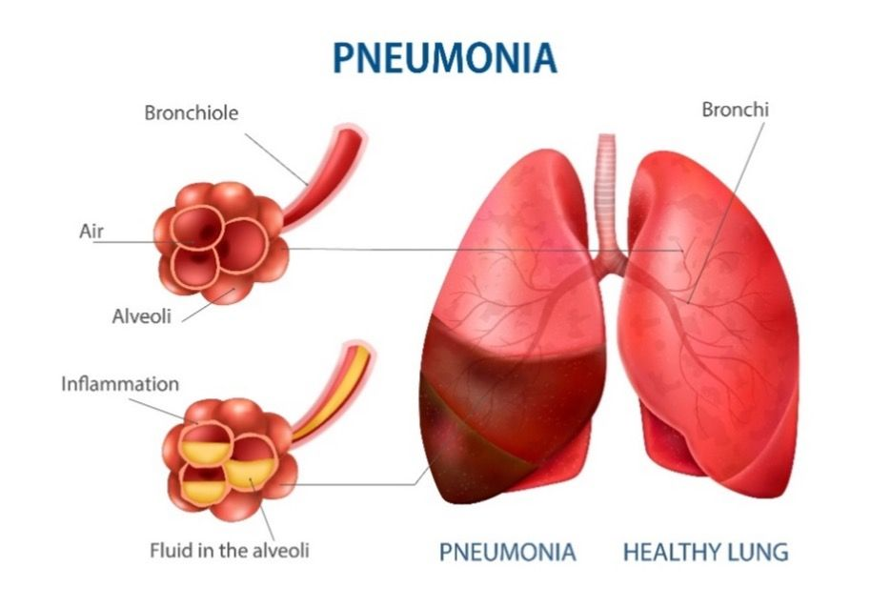
Pneumonia
Pneumonia is an inflammation of the lung's alveoli, presenting with symptoms like cough, fever, chest pain, and difficulty breathing.
Causes range from infections (viruses, bacteria) to other factors like certain medications and autoimmune diseases.
Risk factors include chronic lung diseases, diabetes, heart conditions, smoking history, and weakened immune systems.
Diagnosis typically involves symptom assessment, chest X-rays, and lab tests.
It can be categorised by origin, such as community-acquired or hospital-acquired pneumonia.
Roswell Park Comprehensive Cancer Center. (2022, August). Preventing pneumonia. Retrieved from https://www.roswellpark.org/cancertalk/202208/preventing-pneumonia
References:
https://www.nhs.uk/conditions/pneumonia/
https://www.healthline.com/health/pneumonia
Notes:
What is pneumonia?
Pneumonia is an inflammatory lung condition affecting the alveoli. Its symptoms range from cough and chest pain to fever and breathing difficulties. The severity varies, significantly influencing diagnostic and treatment strategies.
Diagnosis commonly relies on physical examination, supported by chest X-rays and other tests to visually confirm the extent of lung involvement. It can be categorised by origin, such as community-acquired or hospital-acquired pneumonia.

Slide 4
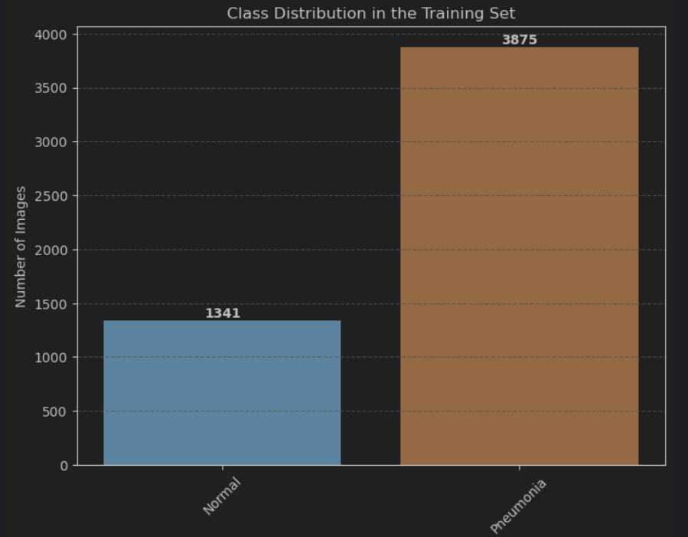
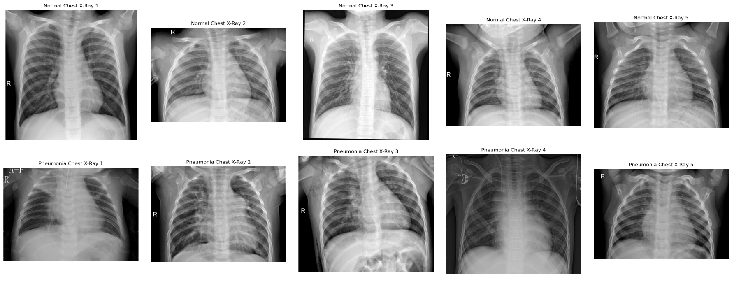
Data Overview
Dataset Organisation: Comprised of three folders: train, test, and validation.
Image Categories: Contains subfolders for each category—Pneumonia and Normal.
Total Images: Consists of 5,863 X-ray images in JPEG format.
Age Group: Images from paediatric patients aged one to five years.
Source: Sourced from Guangzhou Women and Children’s Medical Centre, Guangzhou.
Quality Control: Images were screened for quality, removing low-quality or unreadable scans.
Diagnosis Process: Diagnoses were graded by two expert physicians
References:
https://www.kaggle.com/datasets/paultimothymooney/chest-xray-pneumonia
https://www.kaggle.com/code/getanmolgupta01/chest-x-ray-pneumonia-diagnosis-with-cnn
Notes:
The dataset selected is well-organised into training, testing, and validation sets, which includes a total of 5,863 high-quality X-ray images. These images represent two primary categories—'Pneumonia' and 'Normal.'
The images were sourced from paediatric patients Guangzhou Women and Children’s Medical Centre.
Moreover, to ensure the accuracy of the diagnoses used for training our AI model, each image was initially graded by two expert physicians. A third expert then reviewed the evaluation set to address any discrepancies and prevent grading errors.
This dataset preparation allows us to train our predictive model with high-quality data, enhancing the accuracy and reliability of our pneumonia detection, which is crucial for clinical application. This dataset not only provides a solid foundation for our model but also ensures that our results are based on dependable and clinically validated data.

Slide 5

Methodology
Model Selection: Utilised Convolutional Neural Network (CNN), ResNet50v2 and K-Nearest Neighbors (KNN).
Rationale: CNN for advanced image processing capabilities; KNN for baseline comparison.
Preprocessing Steps:
Normalisation of images to standardise pixel values.
Data augmentation to enhance model robustness and prevent overfitting.
Jupyter Notebook Code:
Pneumonia_Prediction.ipynb
Notes:
To address the challenges of interpreting chest X-ray images, three distinct models are used, as briefly mentioned already. CNN, is renowned for its effectiveness in handling image data and its ability to capture spatial hierarchies in images making it exceptionally suited for medical imaging tasks like ours.
ResNet is a Residual neural Network structure. It is an innovative neural network created for image classification and is used here as an additional advanced image classification model as a comparison to CNN.
Additionally, KNN is used provide a baseline for comparison, being a simpler and more intuitive model, serves as a good contrast to the deep learning approach of CNN and ResNet.

Slide 6
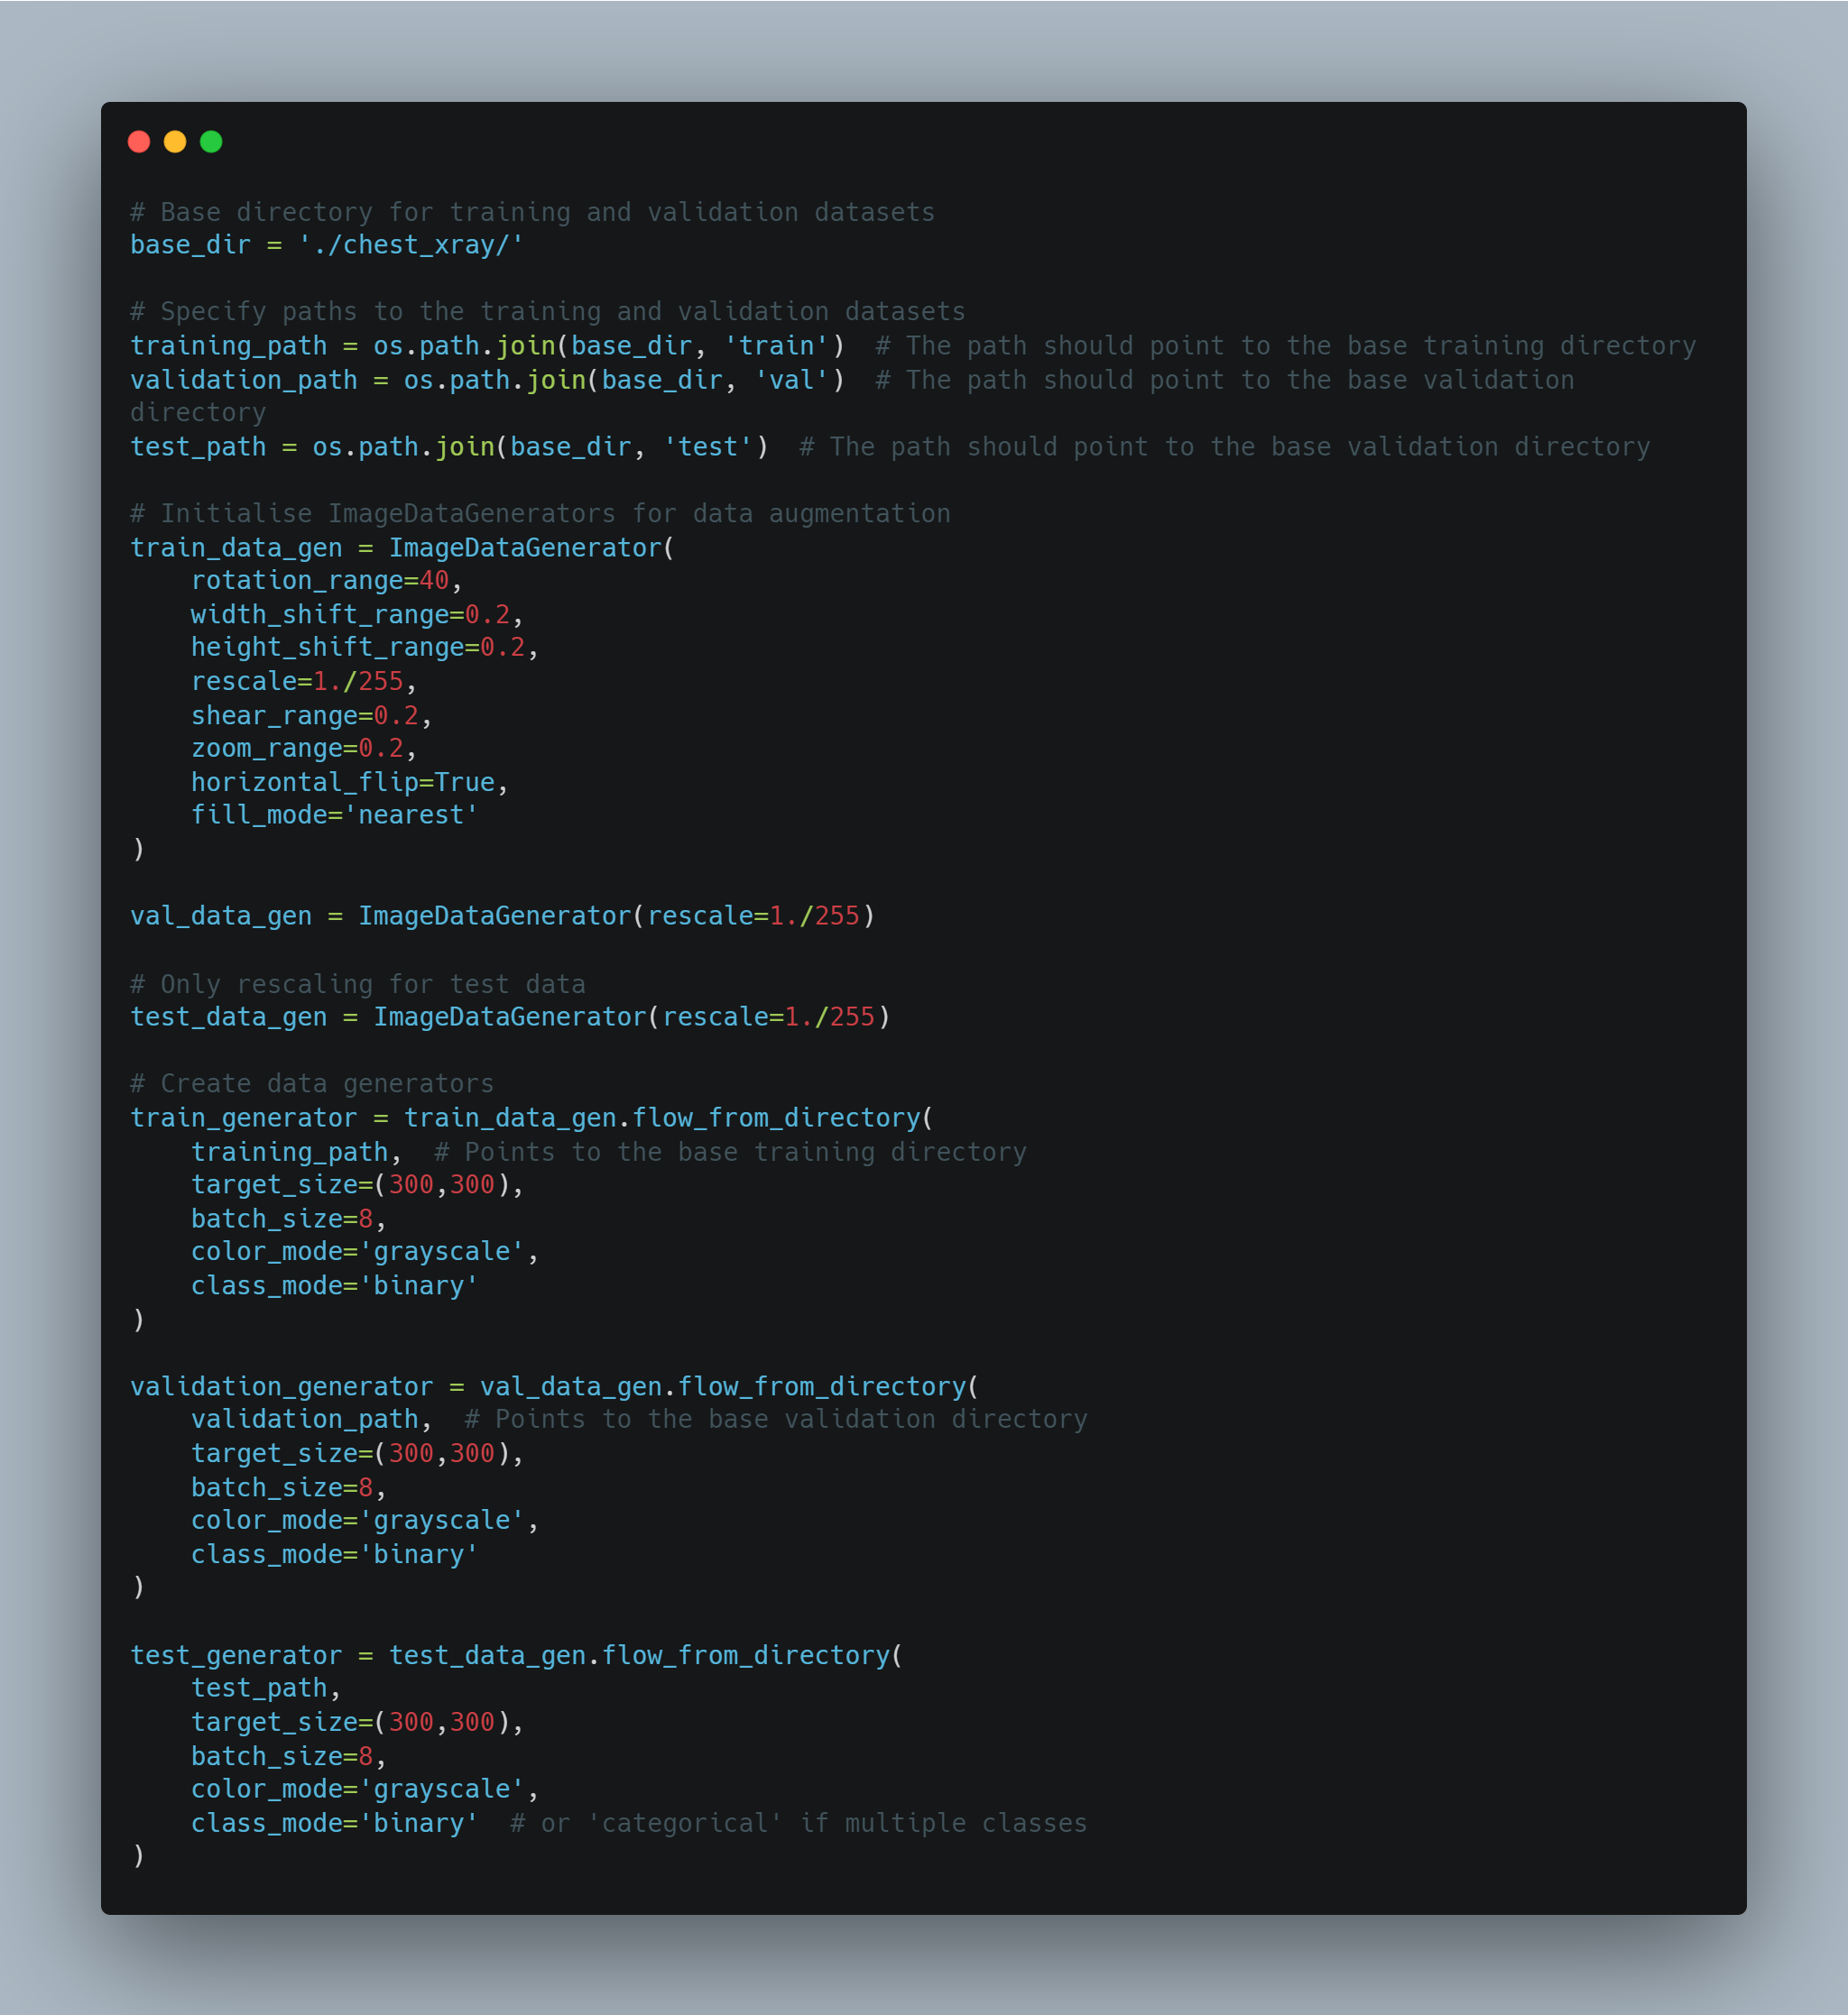
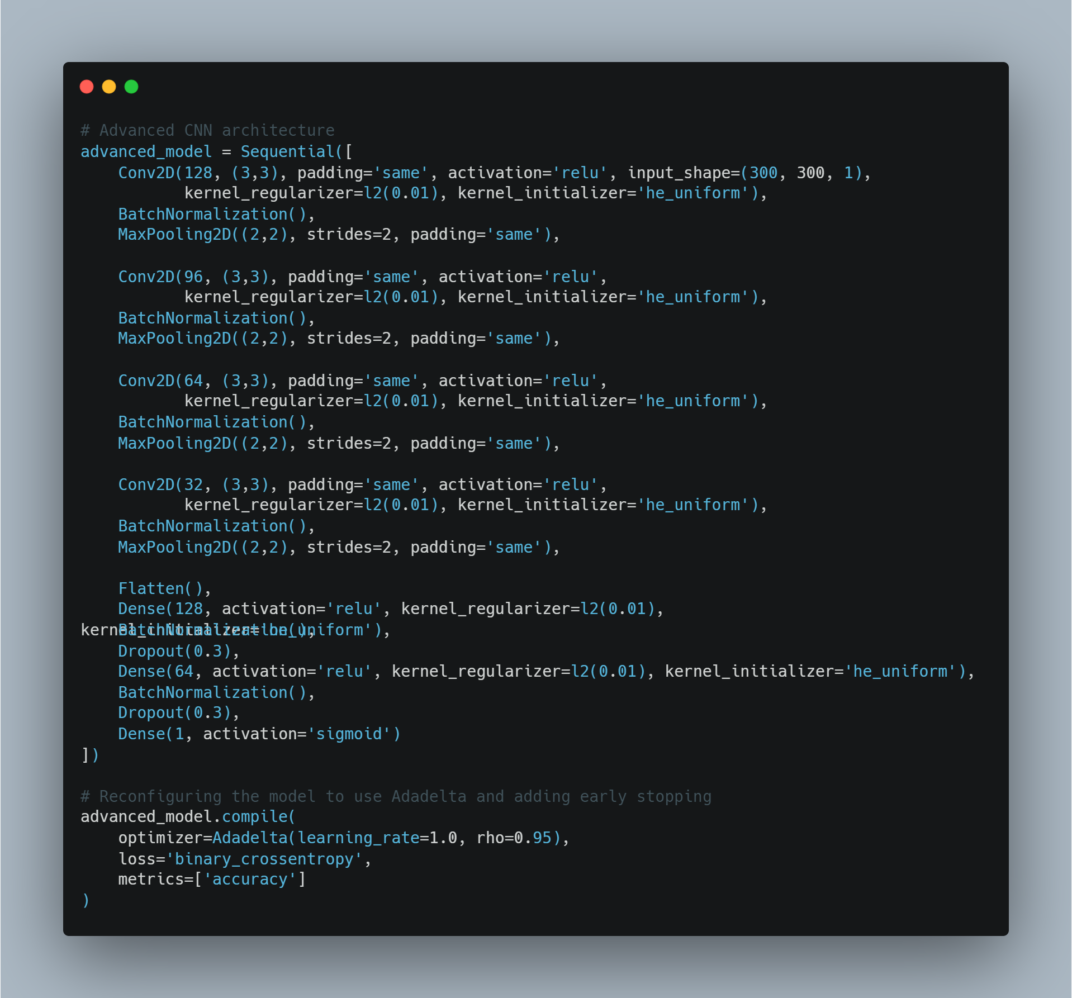
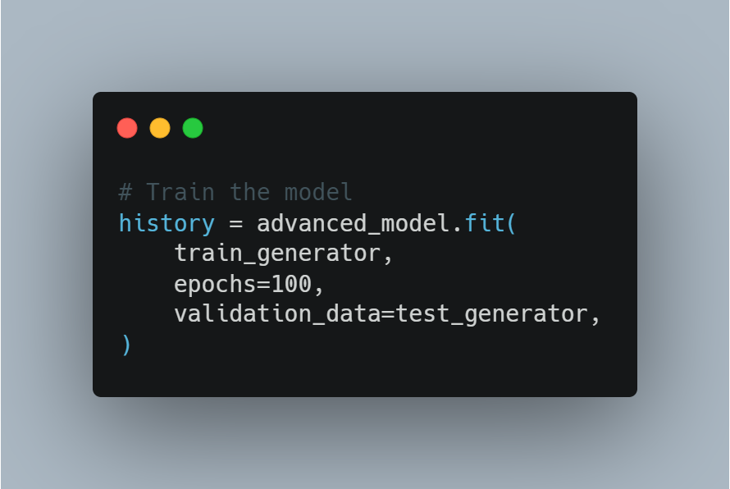
CNN Model Development
Model Training Process
CNN Model Architecture for Pneumonia Detection
Data Preparation and Augmentation for CNN Model Training
Sources:
https://medium.com/@msgold/predicting-images-with-a-cnn-90a25a9e4509
https://machinelearningmastery.com/how-to-develop-convolutional-neural-network-models-for-time-series-forecasting/
Notes:
This slide illustrates the data preparation and augmentation process for training the CNN model. The process involves organising X-ray images into training, validation, and testing sets and applying image augmentation techniques such as rotation, shifting, and flipping. These steps enhance the model's ability to generalise from the training data to real-world scenarios by simulating different imaging conditions, crucial for accurate pneumonia detection. The model undergoes training over 100 epochs—an epoch represents one complete pass through the entire training dataset. This extensive training, paired with real-time validation using a separate test set, ensures that the model learns effectively. It aims to minimise overfitting while enhancing the model’s ability to generalize and make accurate predictions on new, unseen data.

Slide 7
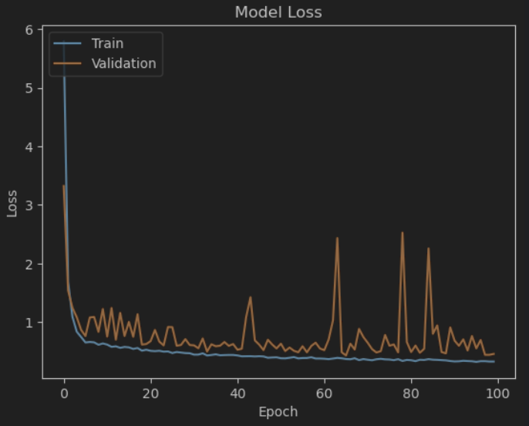
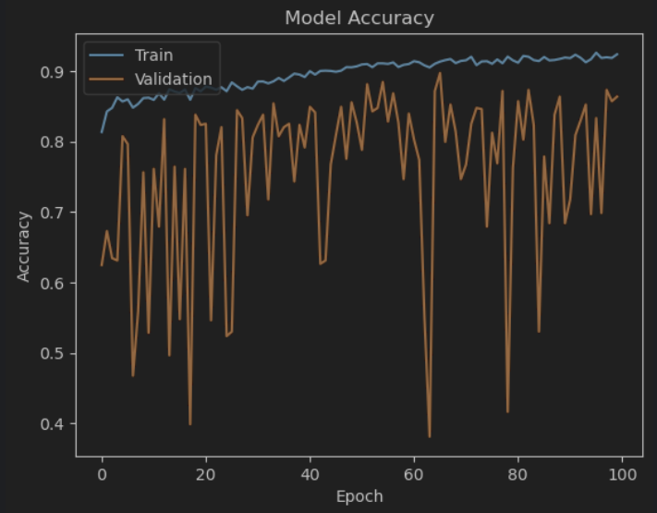
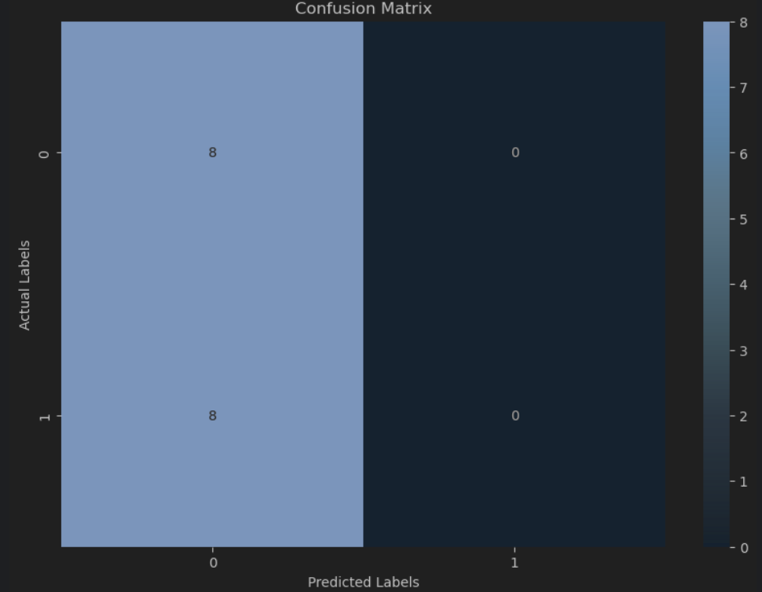
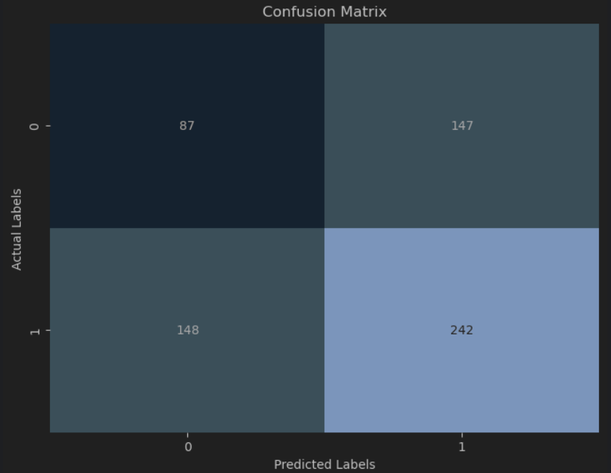
CNN Model RESULTS
Model Accuracy Curve: Displays the accuracy of the model over 100 epochs for both training and validation datasets.
Model Loss Curve: Shows changes in training and validation loss across epochs, indicating model optimisation over time.
Confusion Matrix: Provides a visual breakdown of the model's predictions against the actual labels, highlighting true and false positives/negatives.
Classification Metrics: Details precision, recall, F1-score, and support for each class, giving a comprehensive view of model performance.
Notes:
The Model Accuracy Curve shows the model’s ability to correctly predict pneumonia, reaching an accuracy of 87.5%. This graph plots the accuracy for both training and validation datasets over 100 epochs, illustrating how the model has improved and stabilised over time.
Next, the Model Loss Curve tracks the decrease in both training and validation loss, signifying effective optimisation and learning from the data. This indicates the model’s increasing proficiency in diagnosing pneumonia as training progresses.
The Confusion Matrix's visualise the accuracy of the model’s predictions. It distinctly shows the number of true positive and true negative predictions, as well as any errors in the form of false positives and negatives, allowing us to evaluate the model’s precision in real-world scenarios.

Slide 8
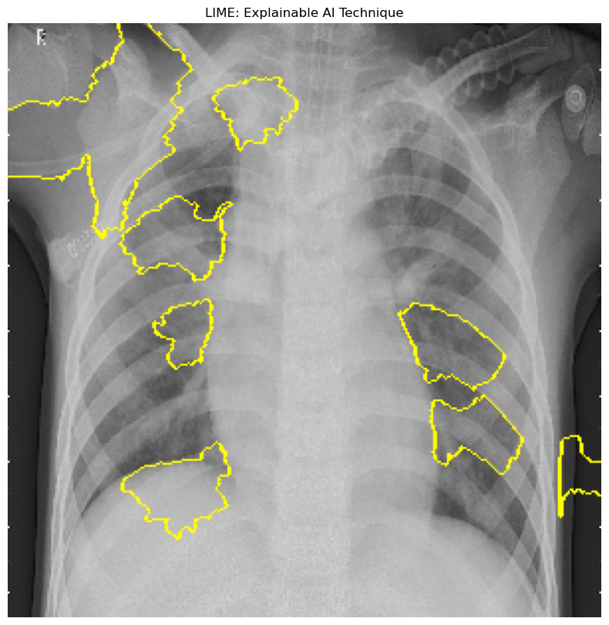
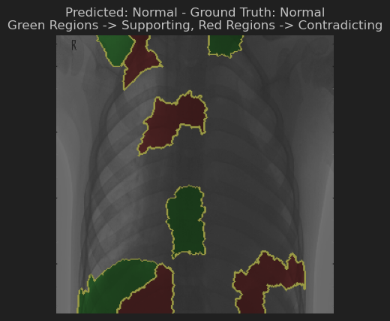
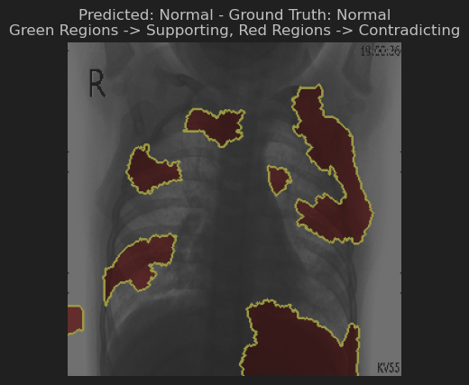
Explainable AI (XAI) Techniques
Overview of LIME: Introduction to LIME as a technique that highlights influential regions in X-ray images.
Visualisation of Influence: Examples showing areas that positively or negatively impact the model's predictions.
Color-coded Interpretations:
Green Regions: Indicate features that support the model's decision, suggesting typical characteristics of the predicted class.
Red Regions: Highlight features that, if dominant, could lead to an alternative decision, showcasing areas where the model sees contradictory evidence.
Notes:
For the Explainable AI techniques LIME was utilised, which clarifies why certain predictions were made by the CNN model.
The first image outlines the areas considered significant by the model in making its prediction, providing a straightforward view of what features the model focuses on.
In the other examples, you can see different chest X-ray images outlined with colour-coded regions.
Green regions signify where the image characteristics support the model's prediction. For instance, certain textures or patterns typical of a normal lung might be highlighted in green, reaffirming the model's decision for a 'Normal' prediction.
Red regions, on the other hand, point to areas that contradict the prediction. These could be unusual shadows or marks that might typically suggest pneumonia but were not strong enough to sway the model's overall decision in these cases.
Each image was randomly selected to showcase how the model performs across various cases, ensuring that our insights are robust and generalised. This approach not only boosts the trust in our AI system but also aids in understanding and verifying the AI’s decision-making process.

Slide 9
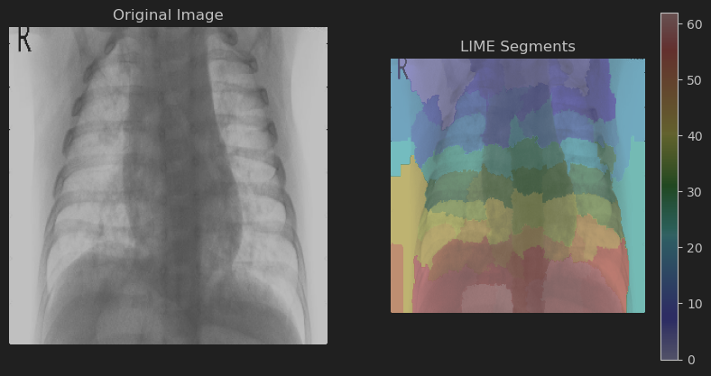
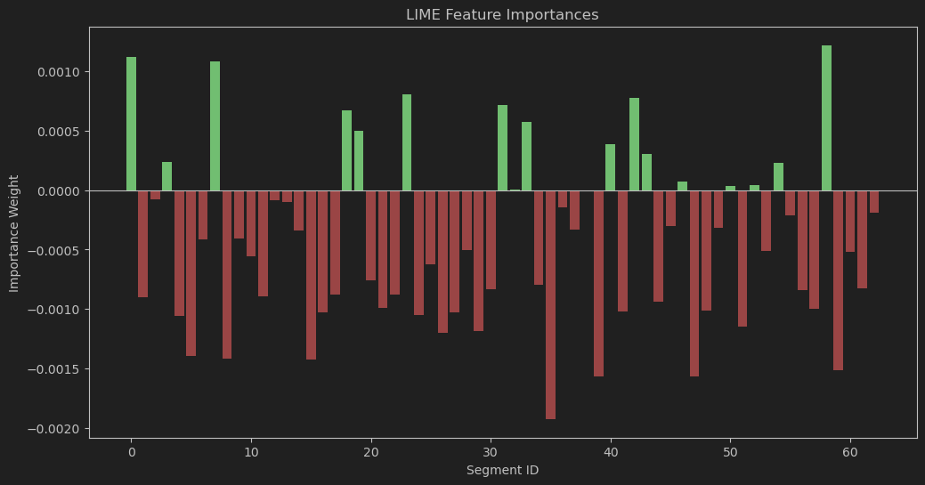
Additional XAI Techniques
Original Image: Shows the raw X-ray used for model evaluation.
LIME Segments: Overlays the X-ray with coloured segments. Each segment represents a superpixel in the image that LIME uses to evaluate how changes in pixel values affect the prediction.
LIME Feature Importances: Displays a bar graph where each bar represents a segment. The colour and height of the bars indicate the impact of that segment on the model's decision—green for positive influence and red for negative.

Slide 10
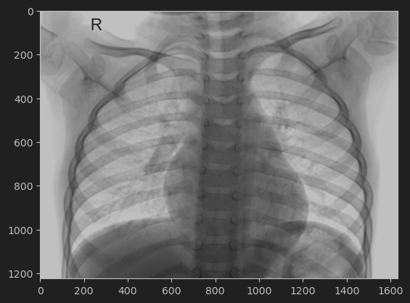
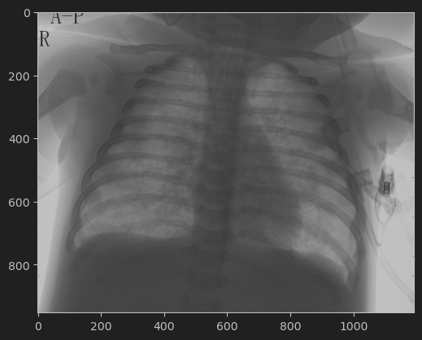
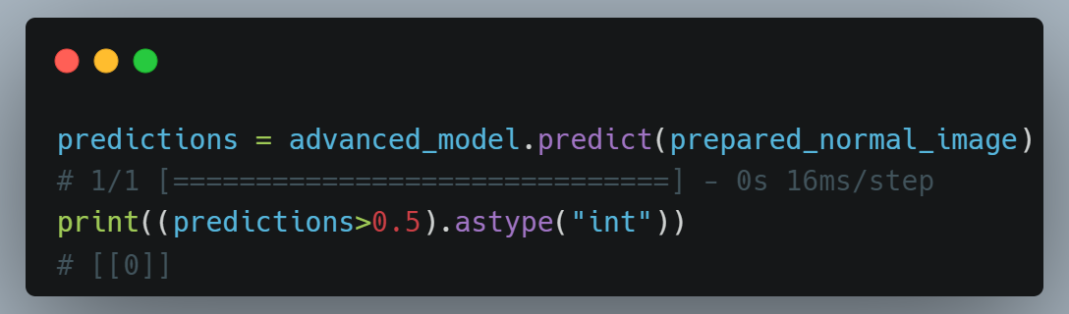
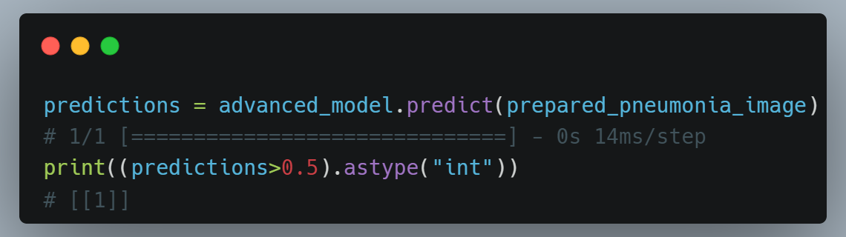
Testing The Developed CNN Model Through Predictions On Random Data
Random Test Data: Showcasing two X-ray images, one normal and one with pneumonia, randomly selected from the test dataset.
Model Predictions: Highlight the results of the model predictions:
Normal X-ray predicted as normal (0).
Pneumonia X-ray accurately identified as pneumonia (1).
Accuracy Confirmation: Confirm the effectiveness of the model in real-world scenarios by demonstrating correct classification.

Slide 11
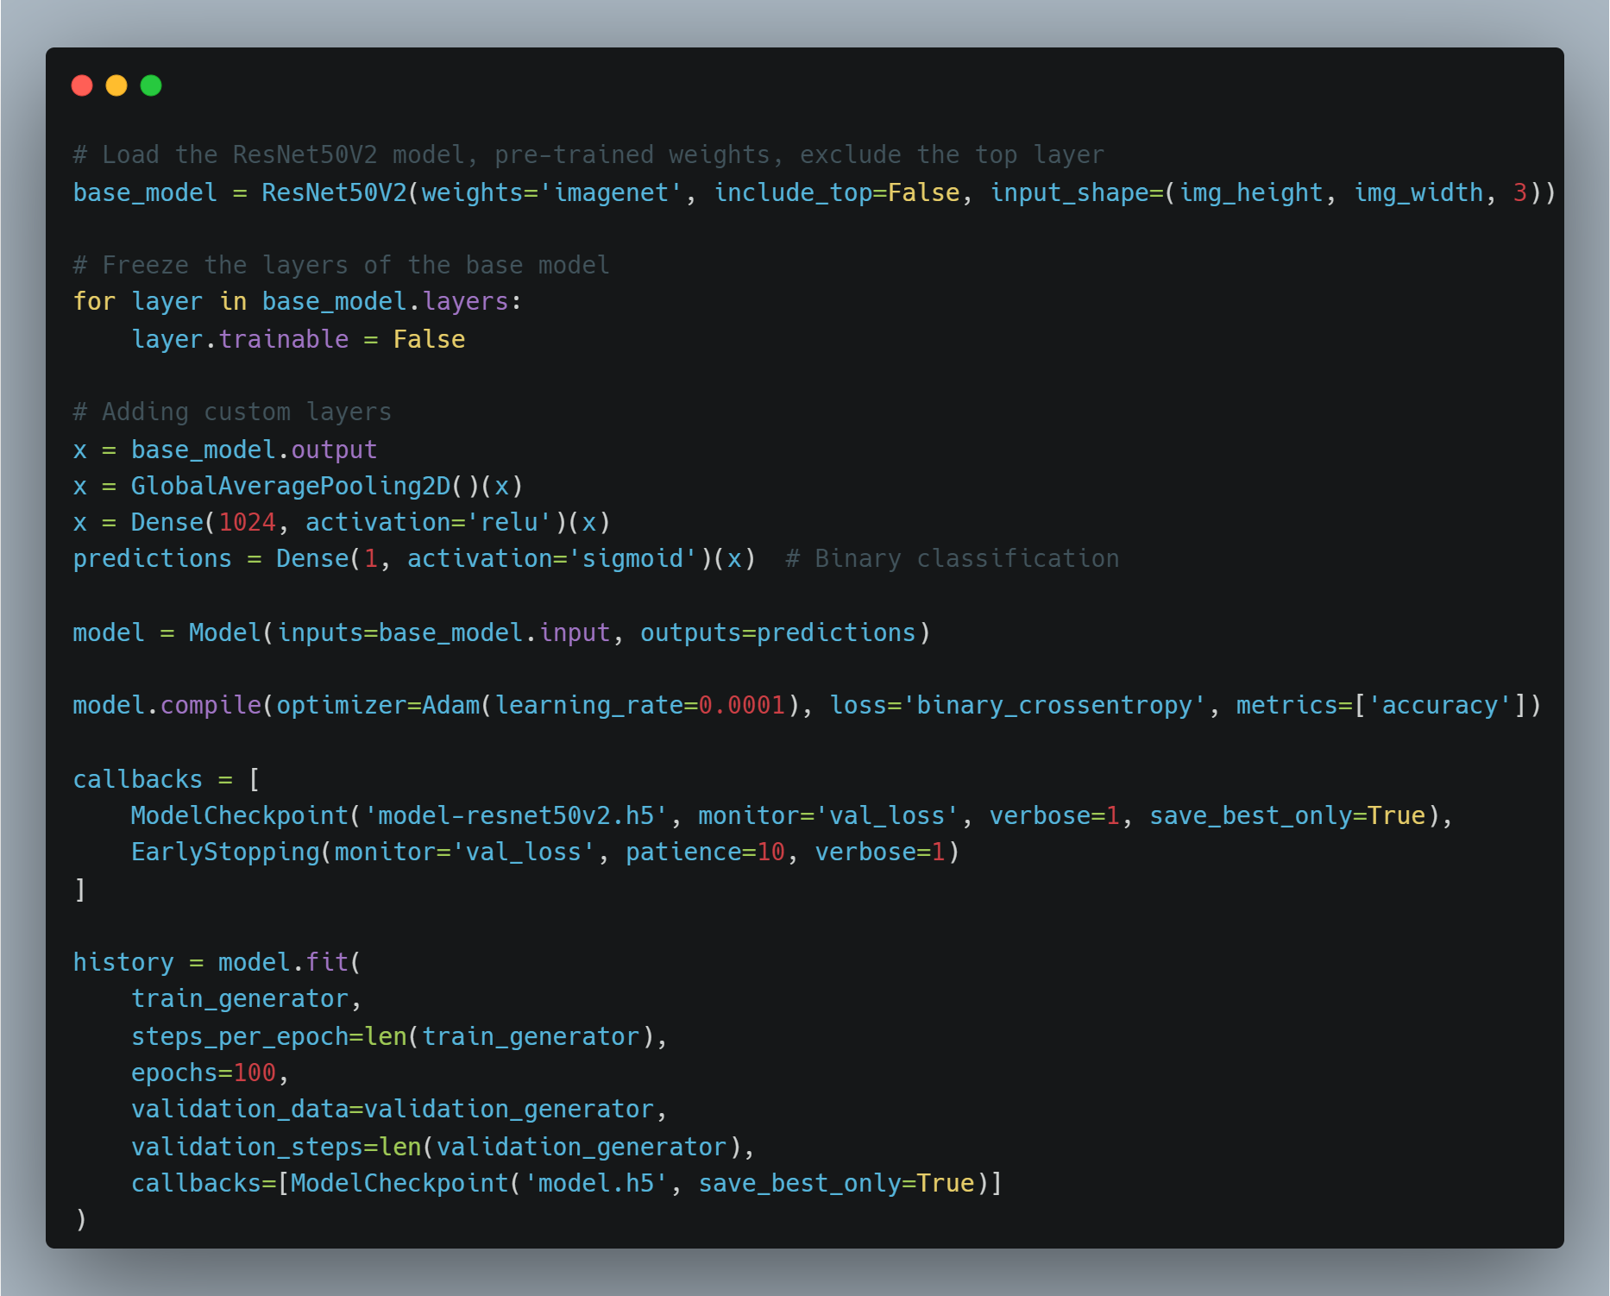
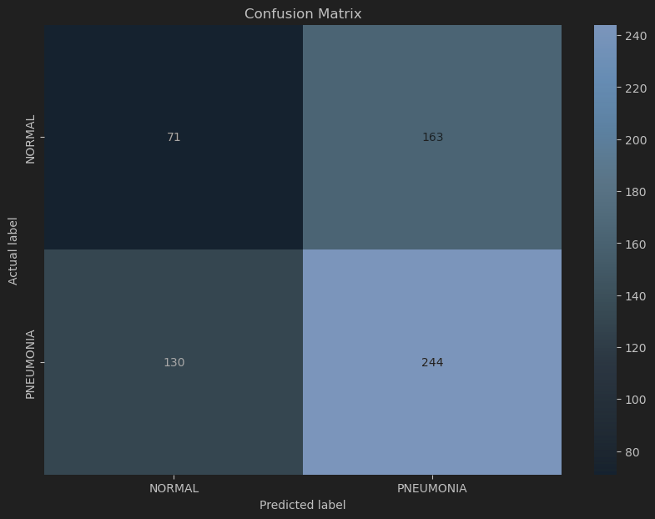
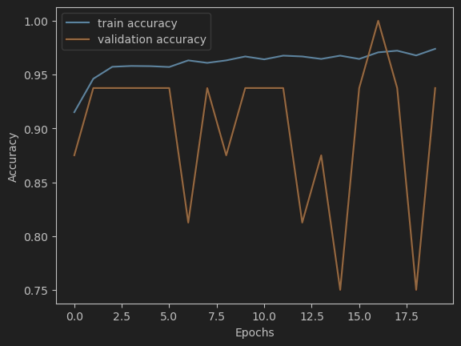
ResNet50V2 model development and results
Training and Validation Accuracy: The graph shows the accuracy of the ResNet50V2 model over 20 epochs for both training and validation sets. With a reported 95% accuracy.
Confusion Matrix: Visual representation of model predictions versus actual labels, highlighting true positives, false positives, true negatives, and false negatives for normal and pneumonia classifications.
Observations:
Training accuracy remains consistently high, indicating effective learning.
Validation accuracy shows variability, suggesting potential overfitting or instability in the model during validation phases.
The confusion matrix shows more false negatives for 'Normal' and false positives for 'Pneumonia', indicating areas for improvement in model sensitivity and specificity.
Sources:
https://www.kaggle.com/code/danushkumarv/pneumonia-detection-resnet
https://www.kaggle.com/code/alisultanov/pneumonia-diagnosis-using-resnet
https://www.kaggle.com/code/eisgandar/pneumonia-detection-with-cnn-vgg16-resnet50v2
Notes:
The ResNet V2 model also went through a similar CNN process but used 20 epochs as a benchmark against the CNN and KNN models. RestNet models are known for their deep learning capabilities, especially in image recognition tasks.
This model is known for its deep learning capabilities, especially in image recognition tasks, making it suitable for complex medical imaging challenges like pneumonia detection.
The training accuracy does hover around 95%, this looks effective however, the validation accuracy looks more volatile with the peaks and dips throughout the different epochs. This could mean overfitting where the model is tuned too closely to the training data, or more sensitive to specifics of the validation set.
The confusion matrix shows 244 correct predictions for 'Pneumonia' and 71 for 'Normal', but there are significant numbers of false negatives and positives—130 and 163, respectively. This result suggests that while the model is proficient at identifying pneumonia, it occasionally misclassifies normal cases as pneumonia, and vice versa, which is critical in a clinical setting.

Slide 12
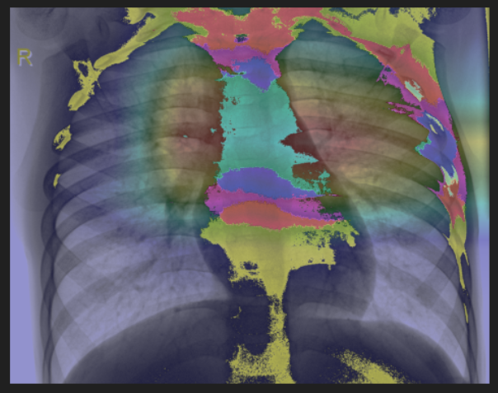
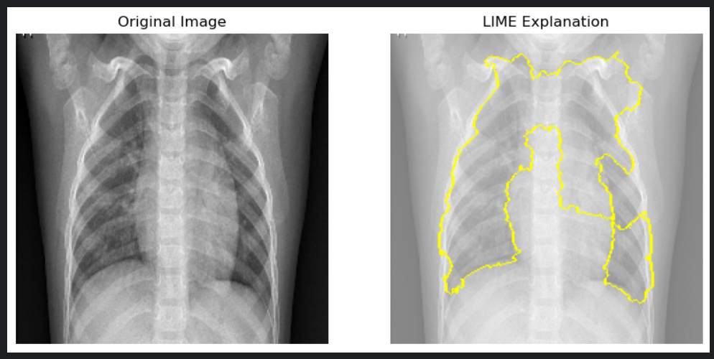
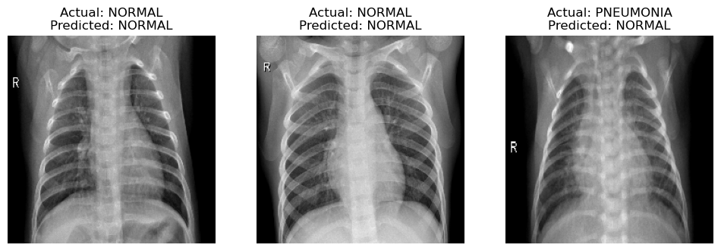
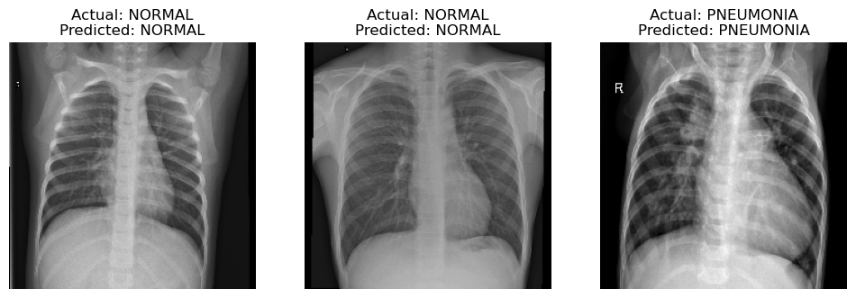
ResNet50V2 Model xai Techniques and Predictions On Random Data
Heatmap Overlay: Coloured heatmap on an X-ray to show regions critical to the model’s decision.
Colour Interpretation:
Cool Colours (Blue, Green): Indicate minimal influence on the prediction.
Warm Colours (Yellow, Red, Pink): Signify areas with significant impact on the model's decision.
LIME Explanation: Yellow outlines highlight the regions influencing the model’s prediction.
Prediction Results:
First set of 3, Pneumonia predicted wrong
Second set of 3, all predicted correctly.
Notes:
The Grad-cam image at the top right displays a heatmap overlaid on a chest X-ray, where each colour signifies the importance of different regions in the model's prediction process. Blue and green represent areas with little to no impact on the outcome, often disregarded by the model. Conversely, warmer colours like yellow, red, and pink highlight critical areas that greatly influence the diagnosis, highlighting features crucial for detecting anomalies.
Below the grad-cam is the LIME XAI. The yellow outlines on the LIME image mark critical regions that significantly influence the model’s prediction.
As confirmed within the ResNet results confusion matrix, there was a significant number of false negatives and positives, and this is proven here within the prediction results, where the first set of 3 predictions show pneumonia being predicted incorrectly, and the second set shows it is predicted correctly. This highlights that even though the model has a high accuracy rating, the model fails to distinguish in a real-world prediction case in some scenarios.

Slide 13
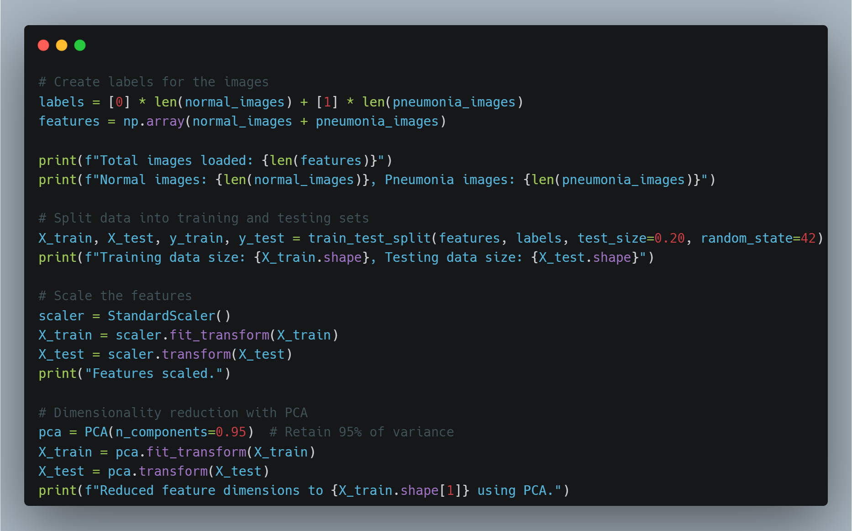
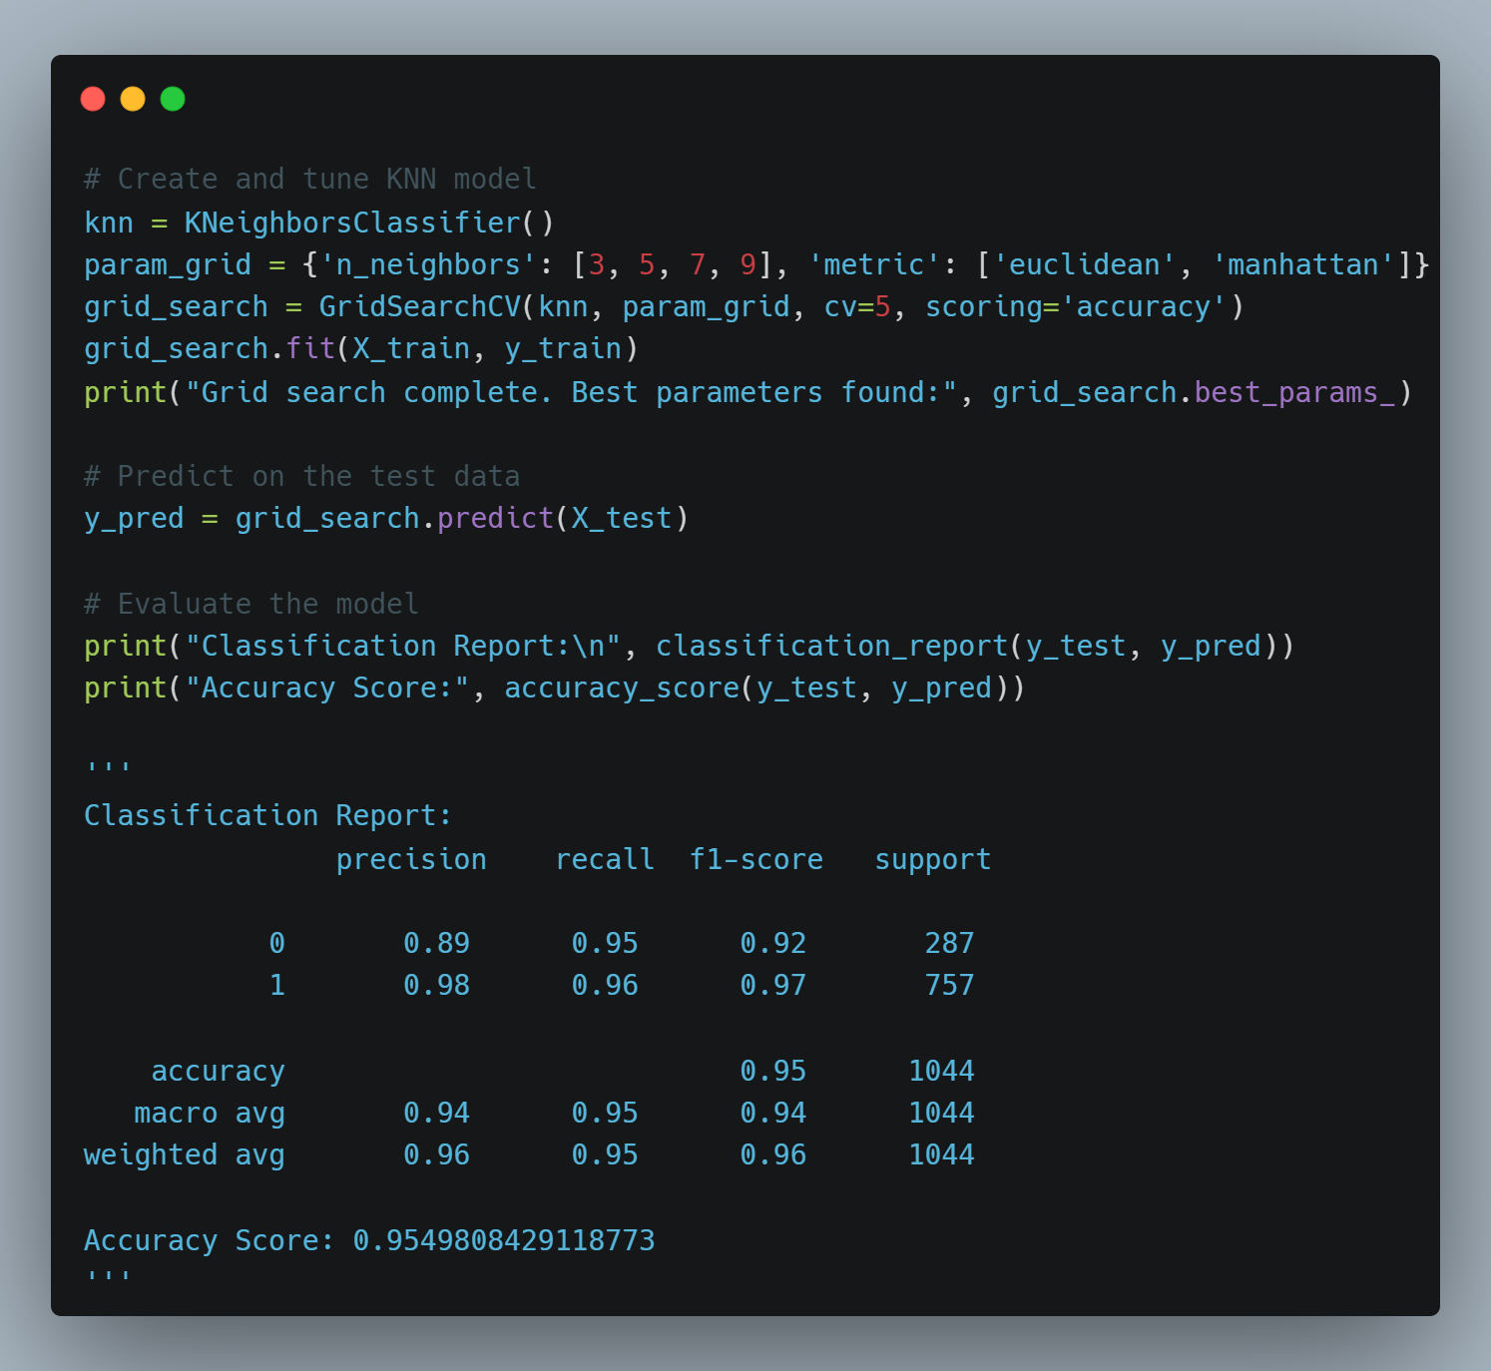
KNN Model Development
Data Preparation for KNN Model in Pneumonia Prediction
Tuning and Evaluation of KNN Model for Pneumonia Prediction
Sources:
https://realpython.com/knn-python/
https://www.analyticsvidhya.com/blog/2018/08/k-nearest-neighbor-introduction-regression-python/

Slide 14
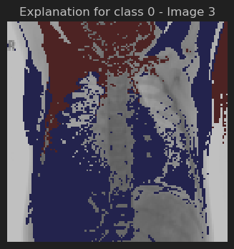
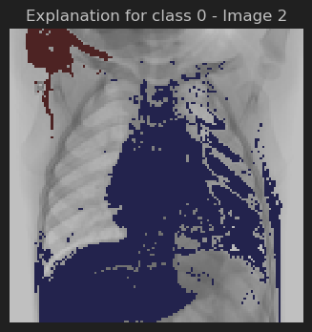
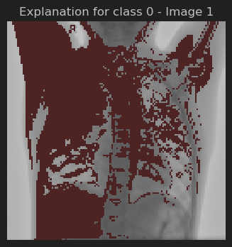
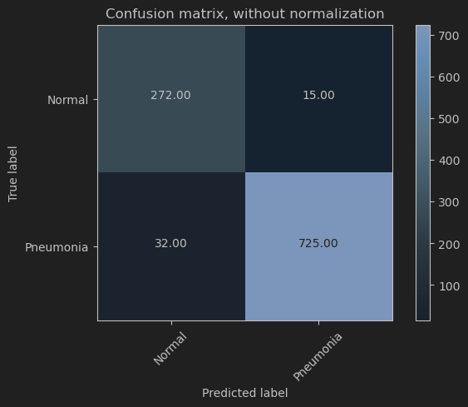
Model Performance:
Accuracy: 95%
Precision for Normal: 89%, Pneumonia: 98%
Recall for Normal: 95%, Pneumonia: 96%
Confusion Matrix Overview:
Highly effective differentiation with minimal false positives and negatives.
Explainable AI Insights:
Red Areas: Indicate regions that strongly support the model’s prediction
Blue Areas: Indicate regions that negatively influence the model’s prediction
KNN Model RESULTS AND xai Techniques
Notes:
The KNN model, tuned through grid search, achieves a notable accuracy score of 95%.
LIME was applied to three randomly selected chest X-ray images. These visual explanations highlight areas in the images that significantly impact the model’s predictions. Red areas on the image enhance the model’s confidence in its prediction, while blue areas suggest a negative influence.
The confusion matrix visualises that The model correctly predicted "Pneumonia" 725 times. The model correctly predicted "Normal" 272 times. The model incorrectly predicted "Pneumonia" when it was actually "Normal" 15 times. The model incorrectly predicted "Normal" when it was actually "Pneumonia" 32 times.
Overall, while the model shows strong performance in many areas, the presence of false negatives suggests a need for further refinement to ensure that no cases of pneumonia are missed, which is critical for medical diagnostic

Slide 15
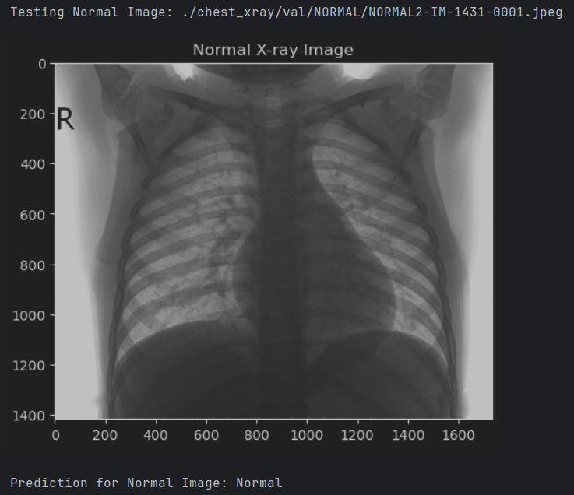
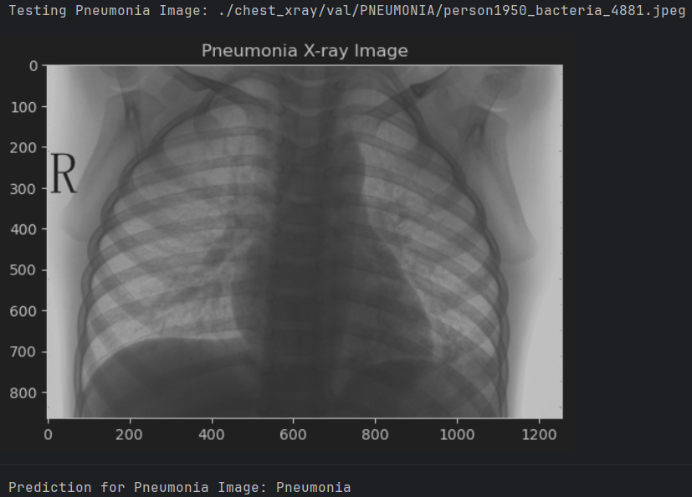
Testing The Developed KNN Model Through Predictions On Random Data
Random Testing with KNN Model: Demonstrates model reliability and predictive power.
Normal X-ray Prediction: Accurately identified as normal.
Pneumonia X-ray Prediction: Correctly diagnosed as pneumonia.
Result: High prediction accuracy on unseen images, validating model effectiveness.
Notes:
In testing the KNN model, two types of chest X-ray images where randomly selected: one normal and one with pneumonia. The model successfully predicted the correct category for both, based on X-ray images. These results confirm that the KNN model can also be trusted for accurate predictions in practical applications, even though used as the base-line, KNN has proven highly accurate.

Slide 16

Evaluation
Model Comparison: CNN vs. ResNet vs. KNN on performance metrics: accuracy, precision, recall.
CNN Training: Trained over 100 epochs, validated against a robust test set.
ResNetV2: Trained over 20 epochs (100 epochs produced 100% results), validated but had high false positive and negative results.
KNN Limitations: Limited training scope, tested only on two categories without comprehensive validation.
Preferred Model: CNN outperforms due to extensive training and more rigorous validation, making it more reliable for complex image data analysis.
References:
https://ieeexplore.ieee.org/document/8782498
https://ieeexplore.ieee.org/document/9872168
https://iopscience.iop.org/article/10.1088/1742-6596/1930/1/012009
Notes:
In evaluating the models, a focus was on key performance metrics: accuracy, precision, and recall. The CNN, trained over 100 epochs and validated against a comprehensive test generator, demonstrated superior performance.
The ResNet50V2, while not as robust as the CNN, outperformed the KNN model. Although ResNet50V2 exhibited a high accuracy rating, it still showed significant false negatives and positives in real-world prediction scenarios, as evidenced by the confusion matrix and prediction results. ResNet was trained on 20 epochs due to computational limitations, as 100 epochs provided an invalid 100% accuracy.
In contrast, the KNN model, while appearing effective, is limited to simpler validations and did not undergo the same rigorous testing regime. And with testing, KNN does report false positives.
While the KNN model predicted well and is merited in its own right, its application in medical imaging is limited. KNN relies heavily on proximity in feature space, which can be problematic in high-dimensional settings typical of medical image data. For these reasons, KNN may not be the best option for medical industry applications where precision and reliability are paramount. The CNN and ResNet50V2's ability to capture spatial hierarchies and patterns makes them far more effective for the detailed needs of medical image analysis.

Slide 17

Conclusion
CNN Superiority: Best performance in accuracy, precision, and recall.
Extensive Training and Validation: CNN trained over 100 epochs, validated with a comprehensive test generator.
ResNet50V2 Limitations: Showed significant false negatives and positives, affecting reliability.
KNN Shortcomings: Limited training scope; lacks rigorous validation, resulting in higher false positives.
Best Prediction Model: CNN’s advanced capabilities in handling complex image data make it the most reliable for medical applications.
Model Suitability: CNN proven most suitable for medical imaging, thanks to its precision and robustness in practical applications.
Notes:
In conclusion, after evaluating the CNN, ResNet50V2, and KNN models, findings clearly indicate that the CNN stands out as the most effective model for pneumonia detection compared to the others. This is largely due to CNN's extensive training in over 100 epochs and its rigorous validation against a robust test set. Unlike the ResNet50V2, which displayed a concerning number of false negatives and positives, and the KNN, which was limited by its simpler training and validation protocols, the CNN consistently showed high performance across all critical metrics—accuracy, precision, and recall. The CNN’s capability to capture complex spatial hierarchies in image data, along with its proven reliability in real-world scenarios, underscores its suitability for deploying in medical imaging applications, where accuracy and dependability are paramount. Therefore, for the objective of this project to "develop a predictive model for diagnosing pneumonia using chest X-ray images", CNN is the best choice.

